Slide 1
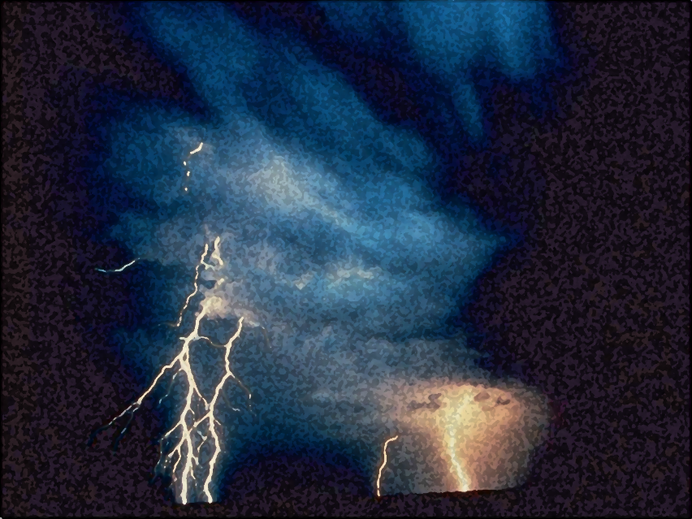
A Light out of Darkness
The Vision of Isaiah
Doom to Bloom

Slide 2
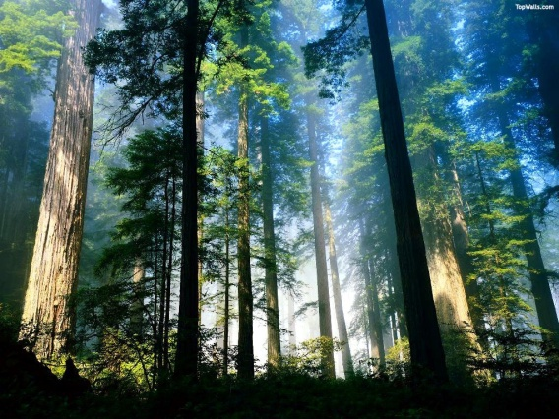
Will You Believe?
Full Bloom
A Restored Israel
Servant Israel
Notes:
Will you believe it. Sinful Israel has become servant Israel. A vision of that day when Israel has become God had intended them to be a light to the nations.

Slide 3
Will You Believe?
A Song of Trust
12:1-6
1-2 – Inwardly Directed
3-6 – Directed Outwardly
Notes:
This song is written not as a summarization, but a conclusion to the previous section 7-11. A climax to what has been said so far.
“Throughout the section there is the recurring appeal to the house of David and to Judah to put aside their fears of the nations around them and to focus their primacy attention on God, who is the master of the nations and who is utterly trustworthy. That trustworthiness is underlined by the promise that although their refusal to trust will issue in defeat and despair, it will not result in complete destruction and annihilation of Israel a people.” (God’s promise to Abraham and David still stands). Although God is under no external obligation to do so, but because of His grace and promise he will deliver them from the chains which they have forged with their own hands and restore them to become a nation of servants to the LORD. (Oswalt, p. 291)
Chapter 12 looks to a time prophetically when the people will have drawn the appropriate conclusions, when the nation as a whole finally gets it. The hearers and the readers are no longer spectators or objects of instruction, but are active participates emotionally, as well as intellectually engaged.
In chapter 11 we see the rule of the branch of Jesse, the character and characteristics of the Son of David, the anointed One, the promise Messiah, and the promise Messianic age to come. This song treats the coming glorious restoration of Israel as an accomplished fact.
[As one author point out it is very strange that chap. 7-11 makes no overt reference to the Messiah, who plays a very significant role in those chapters.]
The song can be divided into two shorter fragments, bringing 7-11 to a fitting close. 1-2 is inwardly directed toward the LORD, where as 3-6 is outwardly directed. The world must know who God is. The world must be enabled to draw the correct implications from the salvation of God’s people.

Slide 4
A Song of Trust
“And in that day you will say: ‘O LORD, I will praise You; Though You were angry with me, Your anger is turned away, and You comfort me.” (12:1)

Slide 5
A Song of Trust
“And in that day you will say:”
A Coming Day of Dread
Notes:
“in that day” is a repeated phrase found throughout Isaiah (used 44 times, NKJV) It is a day to hoped for. A day or great rejoicing. A day of praise.
It is been used already in a diametrically opposite tone from the one found here. Elsewhere the coming day is to be dreaded. There is a coming day of dread, one that even the prophet Moses predicted.

Slide 6
A Song of Trust
“And the LORD said to Moses: ‘Behold, you will rest with your fathers; and this people will rise and play the harlot with the gods of the foreigners of the land, where they go to be among them, and they will forsake Me and break My covenant which I have made with them…”

Slide 7
A Song of Trust
“Then My anger shall be aroused against them in that day, and I will forsake them, and I will hide My face from them, and they shall be devoured. And many evils and troubles shall befall them, so that they will say in that day, ‘Have not these evils come upon us because our God is not among us?...”

Slide 8
A Song of Trust
“And I will surely hide My face in that day because of all the evil which they have done, in that they have turned to other gods.” (Deut. 31:16-18)

Slide 9
A Song of Trust
“And evil will befall you in the latter days, because you will do evil in the sight of the LORD, to provoke Him to anger through the work of your hands.” (31:26)

Slide 10
A Song of Trust
“And in that day you will say: ‘
A Coming Day of Hope
Notes:
There is coming a day of dread on sinful Israel, but here as in 4:2, 10:20, 11:10 and others, is a day to be anticipated, a day of hope, Once again the prophet underlines that judgment is not God’s last word. For all who will, promise lies beyond judgment.

Slide 11
A Song of Trust
“In that day the Branch of the LORD shall be beautiful and glorious; And the fruit of the earth shall be excellent and appealing for those of Israel who have escaped [survived].” (4:2)

Slide 12
A Song of Trust
“And it shall come to pass in that day that the remnant of Israel, and such as have escaped of the house of Jacob, will never again depend on him who defeated them, but will depend on the LORD, the Holy One of Israel, in truth.” (10:20)

Slide 13
A Song of Trust
“And in that day there shall be a Root of Jesse, Who shall stand as a banner to the people; For the Gentiles shall seek Him, and His resting place shall be glorious.”(11:10)

Slide 14
A Song of Trust
“And the LORD alone shall be exalted in that day… (2:11, 17) “In that day a man will cast away his idols of silver and his idols of gold…” (2:20; 31:7)

Slide 15
A Song of Trust
“In that day the LORD of hosts will be for a crown of glory and a diadem of beauty to the remnant of His people…” (28:5)

Slide 16
A Song of Trust
“In that day the deaf shall hear the words of the book, and the eyes of the blind shall see out of obscurity and out of darkness. The humble also shall increase their joy in the LORD, and the poor among men shall rejoice in the Holy One of Israel.” (29:18)

Slide 17
A Song of Trust
“Therefore My people shall know My name; Therefore they shall know in that day that I am He who speaks: ‘Behold, it is I.’, (52:6)

Slide 18
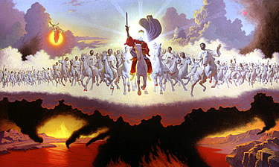
A Song of Trust
“In that day the LORD will defend the inhabitants of Jerusalem;… It shall be in that day that I will seek to destroy all the nations that come against Jerusalem.” (Zech. 12:8-9)

Slide 19
A Song of Trust
“O LORD, I will praise You;”
“yadah Yehovah”
“I will praise you, LORD”
“praise” to use an open hand
Notes:
The central focus is on God, the LORD, Yehovah, for which Isaiah has been appealing for. Whereas the focus of the people was on themselves and the nations for the supply of their needs and their security, a prescription for disaster.
Praise, “yadah” and thanksgiving is essential to a robust spiritual life, not because God needs it, but because we need to give it. “It is the only way we can refocus our attention upon how much we have receive from a loving Father and in that appreciation stop attempting to use him as our servant, like a big cosmic vending machines.

Slide 20
A Song of Trust
“Though You were angry with me, Your anger is turned away, and You comfort me.”
“anaph” a primitive root; to breathe hard, i.e. be enraged.
(Strong’s Definition)
Notes:
The source of the praise is the discovery that God’s anger has been removed and the former enemy has become a source of encouragement and support.
Why is God so angry? God’s anger is based on a just cause. It is the result of His holy nature. Our sin is an offense against the laws of the universe and against a loving Father. It cannot be merely dismissed, written off, shoved under the rug.

Slide 21
A Song of Trust
“Though You were angry with me, Your anger is turned away, and You comfort me.”
“nacham” a primitive root; to sigh, i.e. breathe strongly.
(Strong’s Definition)
Notes:
The comfort only comes after the sin and iniquity has been punished. The people were fully aware of this, “It is the blood that make atonement” (Lev. 17:11). “without the shedding of blood, there is no forgiveness for sin.” (Heb. 9:22) They understood that some sort of atoning sacrifice had been made that God’s just anger had not merely disappeared but was redirected toward another victim. But what or who could take the place of another person’s sin?
The prophet Micah asked can what “will the LORD be pleased with, thousands of sacred rams, ten thousand rivers of oil, even one’s children?” (6:6-7) How much is enough to take the sinner’s place? Answer, it is never enough!
This song asks the question by implication. How is God’s anger to be turned to comfort? From where will come the atoning sacrifice to take away sin? The question is not answered until it is considered in detail in chapters 40-55, where the prophet will boldly say that there is a person who can take the place of the entire people (53:10-12). It now prepares the way for that eventual answer and forces the reader to begin to think about it.

Slide 22
A Song of Trust
“Though You were angry with me, Your anger is turned away, and You comfort me.”
“shuwb” a primitive root;
to turn back or away = “Repent” (Strong’s Definition)

Slide 23
A Song of Trust
“Behold, God is my salvation, I will trust and not be afraid; 'For YAH, the LORD, is my strength and song; He also has become my salvation.” (12:2)

Slide 24
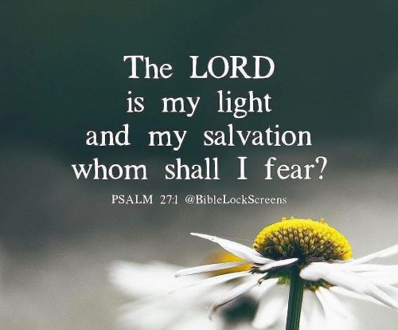
A Song of Trust
“Behold, God is my salvation”
Notes:
It is not merely that God saves, but that He is salvation. It expresses the truth that there is salvation in no other apart from God.

Slide 25
A Song of Trust
“My soul, wait silently for God alone, for my expectation is from Him. He only is my rock and my salvation; He is my defense; I shall not be moved. In God is my salvation and my glory; The rock of my strength, and my refuge, is in God. (Psalm 62:5-7)
Notes:
David said, “…God is my salvation” - The only other time the phrase is used in the NKJB.

Slide 26
A Song of Trust
“Trust in Him at all times, you people; Pour out your heart before Him; God is a refuge for us.” (Psalm 62:8)
Notes:
The people did not always trust Him. David exhorts them to do so.

Slide 27
A Song of Trust
“Behold, God is my salvation”
“yeshuw` ah” - salvation, deliverance, aid, victory, help, prosperity: good health and welfare
“If you abide in My word… you shall know the truth, and the truth shall make you free.” (John 8:31-32)
Notes:
To know Him is to know deliverance and not to know him is to be deluded about deliverance. Freedom, whether political, social or personal is found in God or it is not found at all. Isaiah has heap scorn upon the people for attempts to find deliverance and life in the might and wisdom of the world.

Slide 28
A Song of Trust
“Behold, God is my salvation”
“yeshuw` ah” - salvation, deliverance, aid, victory, help, prosperity: good health and welfare
“And this is eternal life, that they may know You, the only true God, and Jesus Christ whom You have sent.” (John 17:3)
Notes:
To know Him is to have eternal life. If you have believed in Him for eternal life then you also know and believe that He keeps His promises, God can be trusted. You must also know that He is good for He offers the good life. You must also know and believe that He loves you despite your sin, for why else would He offer this gift?
Not no know and believe that God can be trusted is not to believe in the promise of eternal life. If God is not good, loving, kind and forgiving why would He offer life to wrenched sinners such as I?

Slide 29
A Song of Trust
“I will trust and not be afraid;
Notes:
This is what Isaiah was attempting to get Ahaz to say in chapter 7. Ahaz could not say it. Overcome with fear he could not believe that God was with Him. Instead He put his trust in Assyria, his ultimate enemy.
How can God get Judah to believe that He is really with them? How can sinful Israel forsake their pride and manipulative religion and become servant Israel able to commit themselves to God. Ultimately, this change will be possible only when God in an act of free grace moves on their behalf in history. A return from exile in 539 BC was such an act of grace, never in history has such a thing occurred. On par with the establishment of the nation of Israel in 1948. The preservation of the Jews through history against all odds and nations against them.
There has been a even more climatic demonstration of God’s free grace in His Son. “Should we not trust a God who would, without any prior commitment on our part, give us his Son for us? Only fear, fear that God will not keep His word, keep His promise, fear of giving up control, can keep us from trusting Him.” (Oswalt, p. 293)

Slide 30
A Song of Trust
“'For YAH, the LORD, is my strength and song; He also has become my salvation.”
Notes:
In that day when the Jews look upon the One who was pierced, then all of Israel will be saved and all will proclaim that the LORD Yahovah is their salvation.
When Israel was delivered from slavery and annihilation by the hands of the Egyptian army they broke out in song. It will be when the earth is delivered into the hands of the Lamb of God that a great multitude of angels and saints will be singing.
“For song is the natural expression of the spirit which is free, and no spirit is so free as that one which has discovered that its destiny is not dependent upon its striving but rather upon the infinite power of the Almighty.” (Oswalt, p. 294)

Slide 31
A Song of Trust
“In that day this song will be sung in the land of Judah: ‘We have a strong city; God will appoint salvation for walls and bulwarks. Open the gates, that the righteous nation which keeps the truth may enter in. You will keep him in perfect peace, whose mind is stayed on You, because he trusts in You. Trust in the LORD forever, for in YAH, the LORD, is everlasting strength.” (26:1-4)

Slide 32
A Song of Trust
“Therefore with joy you will draw water from the wells of salvation.” (12:3)
Notes:
There is a change in tense, from the 1st person singular to the 2nd person plural. Verse 3-6 are outwardly directed for the world must know God and the salvation He provides. Servant Israel was to be and will be the vehicle whereby the nations can come to God. This theme is introduced here but is allowed to remain dormant until chapters 40-55.
Water is a frequently used as an image of salvation, especially in a land as dry as Israel. “What water is to a parched earth, God’s delivering presence is to the one oppressed by sin and bondage.” Joy is expressed when the thirst has been satisfied. There was a woman who came to draw water and received the living water. Everlasting joy is expressed when everlasting water is drawn that provides everlasting satisfaction.

Slide 33
A Song of Trust
“And in that day you will say: ‘Praise the LORD, call upon His name; Declare His deeds among the peoples, make mention that His name is exalted. Sing to the LORD, For He has done excellent things; This is known in all the earth.” (12:4-5)
Notes:
Verse 4 has many parallels to Psalm 105:1 and 148:13.

Slide 34
A Song of Trust
Praise – “yadah”
Call – “qara’”
Declare – “yada”
make mention – “zakr”
Sing – “zamar”
Cry out and shout –
“tsahal” and “rana”
Notes:
Praise – “yadah” – to use the hand
Call – “qara’” – to cry out to by name
Declare – “yada” to make known
Make mention – “zakar” – to mark or record
Sing – “zamar” – to strike with the fingers, to make music.
Cry out and shout - “tsahal” – to make clear; “ranan” – to speak loudly, usually with joy.

Slide 35
A Song of Trust
“And in that day you will say: ‘Praise the LORD, call upon His name; Declare His deeds among the peoples, make mention that His name is exalted. Sing to the LORD, For He has done excellent things; This is known in all the earth.” (12:4-5)
Notes:
The name of the LORD is not some magical power associated with the particular letters or sounds of the divine name. Rather it refers to God’s reputation and character. To call on the name of the LORD is to worship Him on the basis of the faithful, delivering character revealed in His behavior… Isaiah predicts that the restored people will gain a new conviction of God’s holy character… and want to make known to those around them.
The Lord alone is high and highly exalted. The world will recognize the uniqueness of His glory.

Slide 36
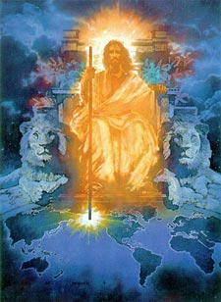
A Song of Trust
“Cry out and shout, O inhabitant of Zion, for great is the Holy One of Israel in your midst!” (12:6)
“Yisra'el” - he will rule as God
“sarah”- to prevail; “el” - God
Notes:
It is not a coincidence that the final verse of this section closes with the phrase “the Holy one of Israel”, for it is the concept that underlines everything. Holiness is the sum total of the attributes of God. It is that which separates God from humanity. It is His character, the content of His holiness that sets Him apart and makes Him different than man made idols. He is righteous, just and true.
After sinful Israel, the inhabitants of Zion, the citizens of Jerusalem, has become holy Israel (4:3) they will then cry out and shout the greatness of the Holy One, who dwells among them.
“In that day” The Holy One that was born, called the Son of God. (Luke 1:35) The One who shall be call by the name “Yeshua” JESUS, salvation. He will be great, and will be called the Son of the Highest; and the Lord God will give Him the throne of His father David. And He will reign over the house of Jacob forever, and of His kingdom there will be no end.“ (Luke 1:31-33)

Slide 37
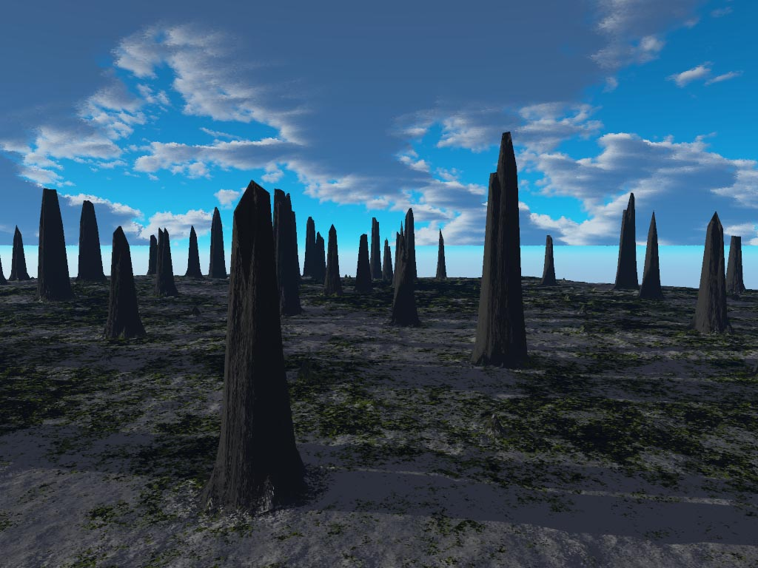
Doom

Slide 38
Bloom
Forever

Slide 39
The Vision of Isaiah

Slide 40
A Song of Trust
“So He said to him, ‘What is your name?’ He said, ‘Jacob.’ And He said, ‘Your name shall no longer be called Jacob, but Israel; for you have struggled with God and with men, and have prevailed.” (Gen. 32:27-28)

Slide 41
A Song of Trust
“Hebrew” - “Ibriy”
an Eberite or descendant of Eber
“Eber” – “the one who crossed over from the east”
An ethic or racial term
The Israelis spoke Hebrew, the language of the east.
Notes:
Eber was a descendent of Shem. (His name may have been given to him prophetically). Where as the Canaanites were from the descendants of Ham and spoke a different language.
“The first person in the Bible called a Hebrew is Abram (Gen 14:13). Thereafter his descendants through Isaac and Jacob were known as "Hebrews" (40:15; 43:32; 2:11). The origin of the name Hebrew offers a difficult problem. The term may be derived from the prominent Semitic progenitor, Eber, the ancestor of Abraham (Gen 10:21). Again "Abram the Hebrew" (14:13) may be "Abram who crossed the river," that is, the Euphrates (Josh 24:2-3).” (The New Unger's Bible Dictionary. Originally published by Moody Press of Chicago, Illinois. Copyright (c) 1988.)
“Shem was "father of all the children of Eber," i.e. of the nations settled eastward, starting from beyond the Euphrates. The name Hebrews, applied to them in relation to the surrounding tribes already long settled in Canaan, continued to be their name among foreigners; whereas "Israelite" was their name among themselves… The name Hebrews is found in Genesis and Exodus more than in all the other Books of the Bible, for it was the international name linking Jacob's descendants with the nations; Israel is the name that separates them from the nations. After the constitution of Israel as a separate people (in Exodus) Hebrews rarely occurs; in the national poetry and in the prophets the name does not occur as a designation of the elect people among themselves. (Fausset's Bible Dictionary, Electronic Database Copyright (c)1998 by Biblesoft)

